Slide 1
When Possession of Minerals Becomes a Mis (Fortune): Coal Mining and Assemblages of Community Celebrations and Protests in Malawi
Sane Pashane Zuka
University of Edinburgh, School of Social and Political Science
PhD Student in International Development

Slide 2
Key Questions and Outline
What are the celebrations and where are they coming from (local communities, civil society organisations, government)
What are the protests and where are they coming from (local communities, civil society organisations, government)
How are the forms of celebrations and protests changing overtime and with what implications

Slide 3
Introduction and Context
Unprecedented levels of investment into Malawi’s extractive sector since early 2000s
Generated imaginations of and optimism for socio-economic development.
  Between 2012 and 2014, >7 coal mining licenses granted
  2007 = Malawi’s Large Scale Mining opens - Kayelekera Uranium Mines
  2003 to present = a number of oil exploration licenses granted (Malawi)
  High optimism that mining will contribute to economic growth and poverty reduction
The extractive industry, however, generates multi-scalar assemblages that champion contentious extractives agendas.
Through the concept of environmental justice, this article explores the evolving patterns of community celebrations and protests against coal mining in Malawi.
These actions highlight the different positions with regard to mining in the country

Slide 4
Environmental Justice
  Environmental movements are “socio-political movements which seek to ameliorate the relationship between human and their natural surrounding” (Temper, 2014: 16).
  Environmental justice aim at addressing environmental harm affecting the marginalised and impoverished groups of people.
  It focuses on how power inequalities within the community is subjecting marginalised groups of people to environmental harm (Alvarez and Coolsaet, 2018).

Slide 5
Understanding Assemblages of Celebrations
Increased investment into mining and the imaginations of economic growth and poverty reduction:
  “We were for a long time told that there are no minerals in Malawi, that was a lie. We have a lot of coal, uranium, gold, graphite and many more minerals. Paladin is mining uranium here and Karonga District will never be the same” (Resident Karonga District. 2010)
  “the table illustrates the potential mineral wealth that could be tapped in Malawi – with great benefits to the people, the economy, the infrastructure and the country” (Civil Society Activist, 2007)

Slide 6
Understanding Assemblages of Celebrations
Increased investment into mining and the imaginations of economic growth and poverty reduction:
  “Mineral sector activity has the potential to generate significant direct and indirect economic benefits for Malawi and, if managed wisely, contribute to sustainable development. ”. (Government of Malawi, 2009)
  “Mr Speaker, Sir, at the outset before I come to specific areas of the bill, let me point out that every time you hear of mines and minerals, what comes to your mind is money. I hope this will be an opportunity for Malawi to make money. Let me request government that this money should be put to good use” (Statement by MCP MP – Opposition)

Slide 7
Key Points to Note
Cross-scalar celebrations based on imaginations of monetary benefits from mining
CSOs present themselves as fighting for the cause of local communities
Government promise corporate social responsibility to benefit local communities and mining revenue to benefit the whole nation

Slide 8
Understanding Assemblages of Protests
Disappointment and ambivalences of Mining Protests
  “We are not involved in anything, we are just told and we are not benefiting anything from this mine. Its government and mining companies that are benefiting ” (Resident, Mchenga Coal Mine, 2019)
  “My worst experience was the Mines and Minerals Act was passed in Parliament. The least I expected from the MPs was to refer it to the relevant committee, but the Act was passed without any amendment. How can CSOs be denied a seat in the mining committee. I was disappointed with the MPs, even after spending time with them before the Bill was presented” (CSO Activist and member of Natural Resource Justice Network, 2019)

Slide 9
Understanding Assemblages of Protests
“Currently, the bill is addressing the issue of establishing a mineral resources committee which is in Section 5. There is no representation from Parliament which is an oversight, the business community and also CSOs or NGOs in this committee. It is also while understandable that the committee cannot be open to a wide selection of stakeholders. The mineral resources committee should be made public at least to make it open to Members of Parliament, NGOs and other organisations (Opposition MP in Parliament, 2017).

Slide 10
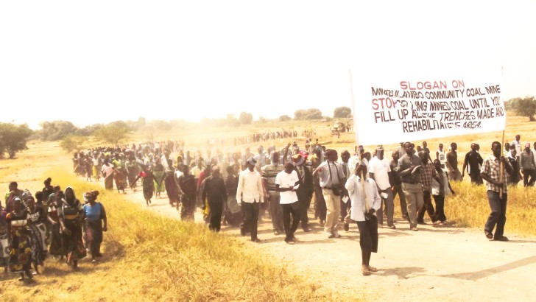
Mwaulambo Community in Karonga Against Coal Mining

Slide 11
Emerging Issues
Celebrations are turning into protests at different scales. Unlike celebrations, protests have displayed different objectives at different scales
Multi-scalar assemblages of celebrations and protests are structuring debates around neo-colonialism, resigned/neo-active activism & contested social-physical geographies.
Mining is being configured not only as a subject of environmental and economic (in)justice, but also macro and micro-resource politics.
Findings signal how, while sustaining disproportionate distribution, contestations over mining benefits is restructuring existing and emerging power entities.
It shows how mining is not only confronted but also generates incentives for its sustenance.

