Slide 1


Researching Informality
State Power and the Dangers of Depoliticizing
Development Discourse
Graeme Young
DSA Scotland
University of Strathclyde
10 January, 2019
Notes:
-talk about some of my work on the political economy of informal economic activity
-present a few insights from my research on into what researching informality reveals about state power and the dangers of depoliticizing development discourse
-most of my research has been in Kampala, Uganda and Cape Town, South Africa, so the examples that I draw on are going to be from those two places, but I think they will have some wider relevance

Slide 2
Argument
Development requires engaging with questions of state power – particularly acute in informal economies
Technocratic approaches that ignore politics creates three potential risks:
  Repression
  Legitimacy
  Silence
Notes:
-argument that I’m going to present in some ways isn’t new, but hopefully viewing it from the perspective of informal economies offers an interesting way of thinking about the questions it addresses
-argument is that development in both theory and practice is fundamentally political and requires engaging with questions of state power—how is power exercised, how it is legitimized, who exercises it, who is excluded from it, what effects it has, how it is implemented and contested
-informal economies are particularly significant sites of state power because they are held to be illegitimate by the state and are subject to constant attempts to regulate, tax, eradicate, develop or otherwise control them
-ignoring these politics and realities of state power and focusing on technocratic approaches to development creates three risks that I want to look at today:
Ignoring or even legitimizing repression
Aiding claims to political legitimacy that are not based in democratic processes
Being silent about the political roots of marginalization and exclusion

Slide 3
Outline
Argument
Understanding Informal Economies
Risk I: Repression
Risk II: Legitimacy
Risk III: Silence
Conclusions
Notes:
-after outlining my argument, I’m going briefly outline what informal economies are and how they can be and are understood
-then I’m going to discuss the three risks of depoliticizing development discourse when understanding informal economies that I mentioned earlier surrounding repression, legitimacy and silence
-finally, I’ll offer a few conclusions to wrap up

Slide 4
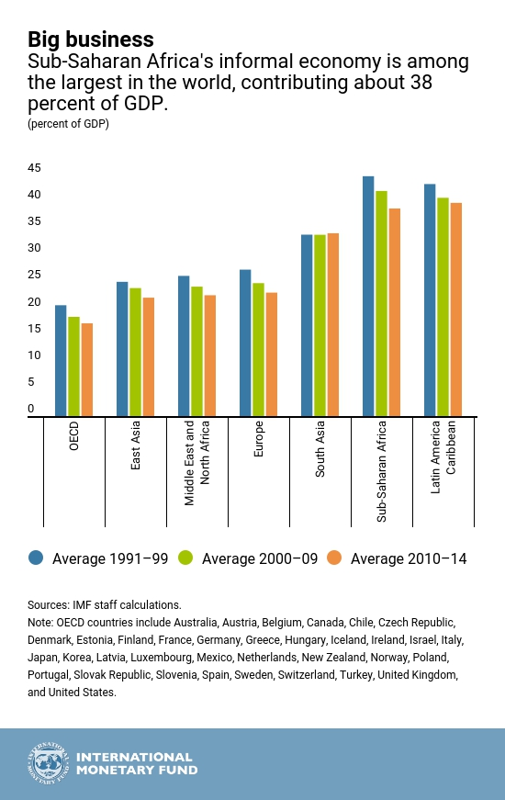
Understanding Informal Economies
Otherwise legal production and exchange outside of state regulatory and revenue apparatus
  Monetary exchange
  Legal goods and services
  Degrees of compliance
Statistics (WIEGO):
  66% of non-agricultural workers in Sub-Saharan Africa
  82% in South Asia
  65% in East and Southeast Asia
  51% in Latin America
Notes:
-so, what are informal economies?
-unfortunately the term is often used vaguely and inconsistently, but a generally common definition from academic and policy literature would be any otherwise legal forms of production and exchange outside of the state’s legal and regulatory apparatus
-this definition has three particularly relevant components:
Involves monetary exchange- excludes non-monetary and barter systems
Goods and services are themselves legal- what makes activity informal is the conditions under which it occurs, not because what is being produced or exchanged has been criminalized
Informality involves failure to adhere to some, but by no means all, relevant regulatory and revenue requirements- often pay some taxes and follow certain legal standards- not simply a binary division
-the informal economy is a major source of livelihoods and a large share of economic activity across the Global South

Slide 5
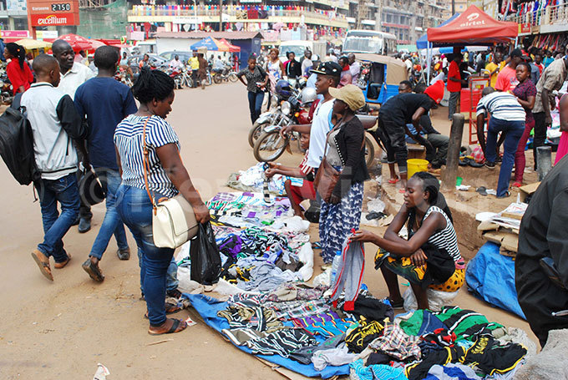
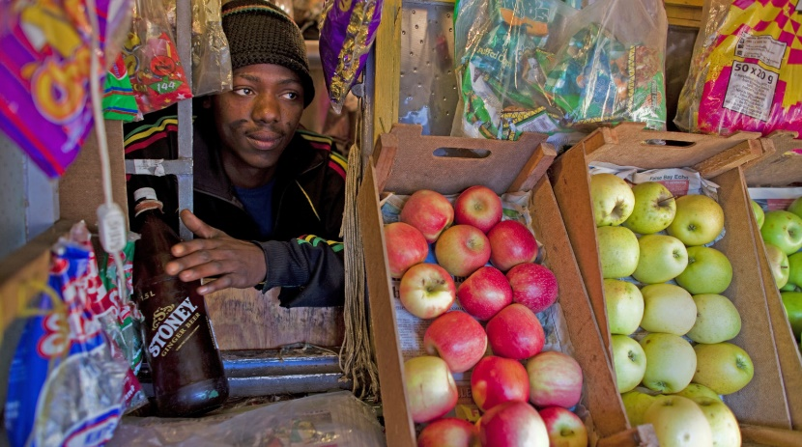
Growing push for formalization
  Little agreement on what this entails
  World Bank, ILO, NUA
Growing criminalization and repression
  Arrests, evictions, fines
  Forced relocations to ‘modern’ structures
Hostility driven by
  Urban development and modernization projects
  Concerns about unfair competition
  Tax, regulatory and legal compliance
Photos: New Vision (Above) and Daily Maverick (Below)
Notes:
-growing push for formalizing informal economies in the international development agenda, but little consensus of what this means in practice- World Bank focuses on promoting economic liberalization, ILO focuses on rights protections, New Urban Agenda stresses formalization through compliance and incentives, but doesn’t detail what this means
-often detached from the national and local level, where there is growing criminalization and repression as the poor are targeted with arrests, evictions, fines and forced relocations to supposedly more “modern” shopping centres
-these are often justified by governments in the name of urban development and modernization projects, concerns about unfair competition for formal businesses and the need for tax, regulatory and legal compliance

Slide 6
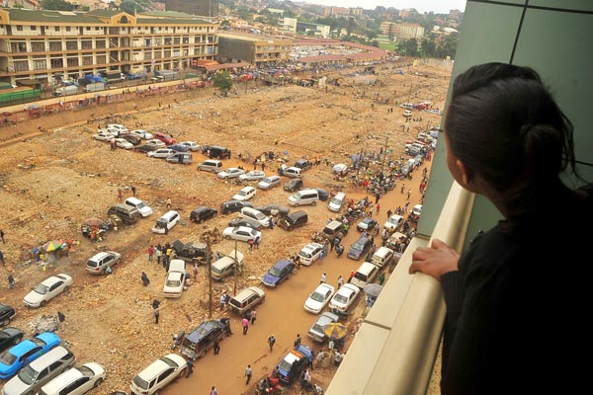
Risk I: Repression
Violence and livelihood effects
Targeting the poor
Targeting political opponents
Photo: Daily Monitor
Notes:
-which leads us to the first risk of ignoring politics, which is that what might be seen as rather neutral compliance initiatives can involve a considerable degree of violence and have major livelihood effects as people lose their means of generating income
-this has significant class dimensions- informality is often associated with the urban poor, who are targeted to raise revenue while the rich often are not, particularly foreign investors and wealthy individuals with ties to the ruling party
-struggle of who and what cities are for- governments prioritize the aesthetic and sometimes economic concerns of middle classes and the wealthy over the livelihood concerns of the poor
-development initiatives can also be used to target the political opponents
-photo shows what used to be Kisekka Market, one of the largest markets in Kampala, which was widely seen as a leading centre of political protest and popular opposition- the market was first sold to a wealthy developer tied to the ruling party, and, after popular protest, given to a second group who demolished the market in 2014 for reconstruction that has not yet happened- criticism that opposition supporters are being driven out of the city

Slide 7
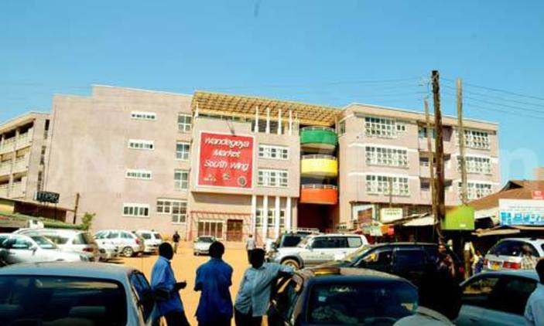
Risk II: Legitimacy
De-democratization
Delivering urban development
  Informality as obstacle to development
  Informality as manifestation of underdevelopment
Aiding legitimacy claims based in technocratic competence rather than democratic processes
Photo: New Vision
Notes:
-this is related to the second risk: ignoring politics can not only neglect realities of repression, but also realities of political control
-in Kampala, the criminalization of street vending and the ongoing formalization drive was initiated after a period of de-democratization- since power in the city was democratized and decentralized in the 1990s, elections were consistently won by the opposition, so the ruling party replaced the elected city government with one that was appointed and centrally controlled in 2011
-move was justified by the need to deliver urban development- informal economy seen to be both a manifestation of underdevelopment and an obstacle to development
-development reports rarely mention this fact- focus on development performance, and in doing so, ignore a major erosion of democracy and adopt ruling party’s view that legitimacy is based on technocratic competence rather than democratic processes
-this has led not only to the criminalization of street vending, but major market redevelopment projects like the redevelopment of Wandegeya Market into a supposedly modern shopping centre, pictured here- rents escalated, few customers returned and poor vendors were driven out, leading the government to claim that average incomes had grown
-more projects like this are planned as they underpin the government’s claims to legitimacy- the impact will likely be similar

Slide 8
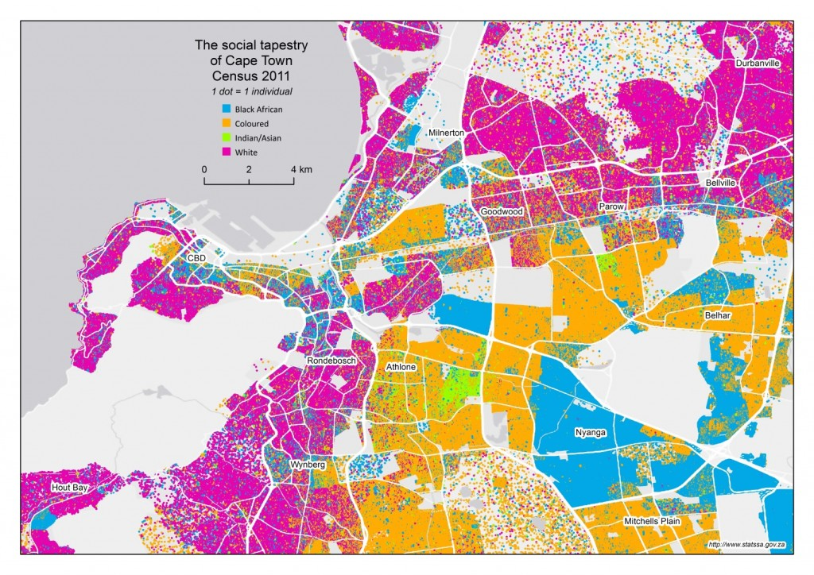
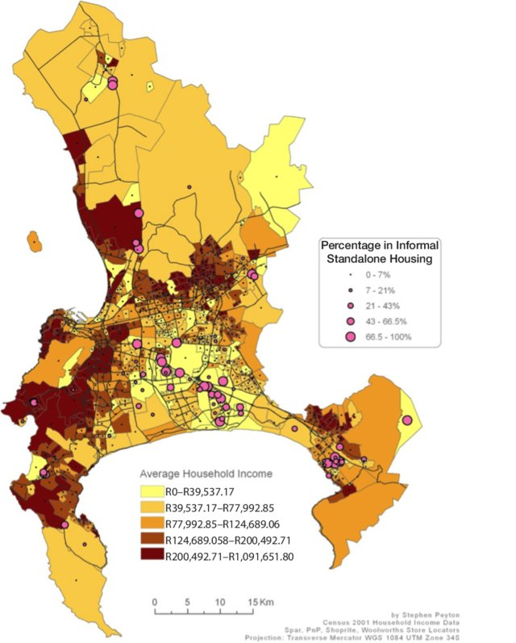
Risk III: Silence
Informality can have deep political roots
Failure to recognize these roots can result in ineffective policy approaches
Racial segregation in Cape Town (Above; Statistics SA)
Average household income in Cape Town (Right; Peyton 2012; and Haysom, Crush and Caesar 2017)
Notes:
-again, because the state has the ultimate authority to determine what are legitimate and what are illegitimate forms of economic activity, informality can have deep political roots
-perhaps the most obvious example of the relationship between state power and economic exclusion can be found in South Africa, where apartheid excluded the majority non-white population from the formal economy, causing informal economic activity to proliferate
-the legacies of apartheid still define South African cities- Cape Town still has high degrees of racial segregation
-I’ve included two maps of Cape Town:
The one on the left shows the racial segregation of the city, with pink dots representing white residents, orange dots representing what are called coloured residents, blue dots represent black African residents and green dots represent Asian residents (http://www.statssa.gov.za/?p=7678)
The one on the right shows average household income levels, with darker colours representing wealthier neighbourhoods- it’s more zoomed out, but you can see the same general pattern- the wealthiest parts of the city are the white neighbourhoods on the Atlantic coast, around Table Mountain and in the Northern Suburbs, while the Cape Flats to southeast of the city centre, where black African and coloured residents are a large majority, is the poorest part of the city and a primary site of informal economic activity (Peyton, Stephen, “Expansion of Supermarkets in Cape Town: The Impact of Market-Based Retail Modernization on Food Insecurity,” unpublished Honours dissertation, Department of Environmental and Geographical Science, University of Cape Town, 2012; and Haysom, Gareth, Jonathan Crush and Mary Caesar, “The Urban Food System of Cape Town, South Africa,” Hungry Cities Partnership, Hungry Cities Report No. 3, 2017).
-Cape Town officially recognizes the importance of informality in the city’s economy and livelihoods
-government officials have adopted an apolitical and ahistorical approach to informality that is in line with the neoliberal views of the World Bank- see the informal economy as a source of entrepreneurship, focus on providing access to credit and skills training to improve business performance

Slide 9
Challenges | Percentage of Vendors
Business Competition
Too many competitors | 67.3
Too few customers | 75.1
Insufficient sales | 59.2
Verbal insults against your business | 13.0
Conflict with local entrepreneurs | 19.6
Competition from supermarkets/large stores | 33.6
Business Costs
Suppliers charge too much | 65.6
Customers don’t pay their debts | 37.9
Lack of access to credit | 18.3
Lack of relevant training in business skills | 29.5
Infrastructure Issues
No refrigeration | 14.5
Storage problems | 22.3
Victims of crime
Theft of goods/stock | 21.7
Confiscation of goods by police | 11.3
Harassment/demands for bribes by police | 7.8
Theft of money/income | 13.3
Physical attacks/assaults by police | 5.4
Arrest/detention of yourself/employees | 4.0
Physical attacks/assaults by citizens | 7.0
Vendor Challenges
Data Courtesy of Hungry Cities Partnership (Tawodzera and Crush 2019)
Notes:
-when the project I was working on surveyed informal food vendors about the primary challenges they face, only a minority pointed to credit and skills constraints
-majorities instead pointed to problems with too many competitors, too few customers, insufficient sales and high prices from suppliers
-real problems in the informal economy are poverty and labour market exclusion, but the government isn’t willing to address those because doing so would require a more fundamental engagement with the legacies of apartheid and a recognition of the failures of the post-apartheid transition to move beyond political and civil rights to address social and economic rights
Tawodzera, Godfrey and Jonathan Crush, “Inclusive Growth and the Informal Food Sector in Cape Town, South Africa,” Hungry Cities Partnership, Hungry Cities Report No. 16, 2019.

Slide 10
Conclusions
Thank you
Depoliticizing development discourse can buttress state power by masking repression, legitimizing anti-democratic politics and silencing the roots of exclusion
Studying poverty and marginalization demands engagement with questions of state power
Graeme Young
Research Fellow
Centre for Sustainable, Healthy and Learning Cities and Neighbourhoods
University of Glasgow
graeme.young.2@glasgow.ac.uk
http://hungrycities.net/
Notes:
-again, development is inherently political, and a failure to recognize this reality in the informal economy risks buttressing state power
-as I’ve outlined here, it does so in three ways:
Ignoring or legitimizing repression
Aiding undemocratic claims to political legitimacy
Being silent about the political roots of marginalization and exclusion
-studying poverty and marginalization demands engagement with questions of state power- we do a disservice, and can even threaten potential harm, when we ignore them

